Slide 1

Decision
Tree
Classifier

Slide 2
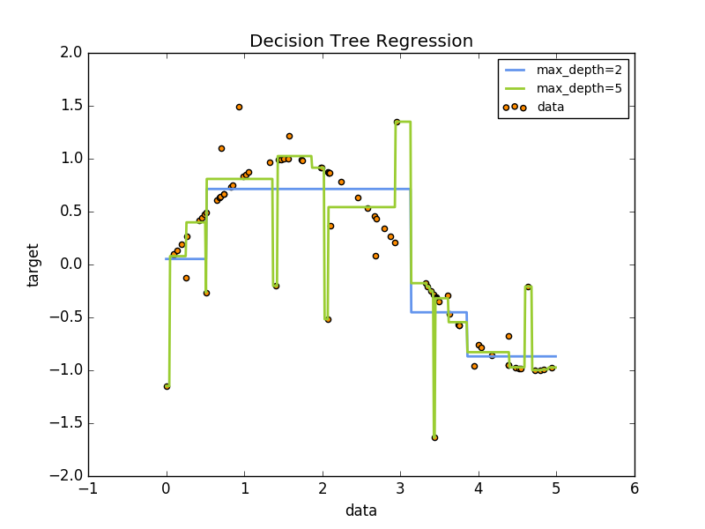
EX: Fitting a SINE curve

Slide 3
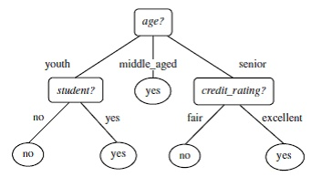
Decisions, Decisions, Decisions…

Slide 4
Algorithm Breakdown
TREE INDUCTION
TREE PRUNING

Slide 5
Tree Induction
Take a set of pre-classified instances as inputs
Decide which attributes are best to split on
Split the dataset
Recurse on the resulting split datasets until all training instances are categorized – (includes pruning: removing unnecessary structures to prevent over-fitting)

Slide 6
Splitting Attributes

Slide 7
Dataset – Training Set
Individual | Age | Student? | Credit Rating | Buys Computer?
Bruce Wayne | Middle Aged | N/A | Does Not Need | Yes
Steve Rogers | Youth | No | N/A | No
James Barnes | Youth | No | N/A | No
Tony Stark | Middle Aged | N/A | Does Not Need | Yes
Peter Parker | Youth | Yes | N/A | Yes
THE Alfred | Senior | N/A | Excellent | Yes
Some Guy | Senior | N/A | Fair | No

Slide 8
Construct the Tree

Slide 9
Dataset – Test Set
Individual | Age | Student? | Credit Rating | Buys Computer?
Superman | Middle Aged | N/A | N/A | ?
Natasha Romanoff | Youth | No | N/A | ?
Rando 1 | Middle Aged | N/A | N/A | ?
Rando 2 | Youth | Yes | N/A | ?
Rando 3 | Senior | N/A | Fair | ?

Slide 10
Testing Our Accuracy…
Individual | Age | Student? | Credit Rating | Buys Computer?
Superman | Middle Aged | N/A | N/A | Yes
Natasha Romanoff | Youth | No | N/A | No
Rando 1 | Middle Aged | N/A | N/A | Yes
Rando 2 | Youth | Yes | N/A | Yes
Rando 3 | Senior | N/A | Fair | No

